Slide 1
2. Linear Applications of op-Amp

Slide 2
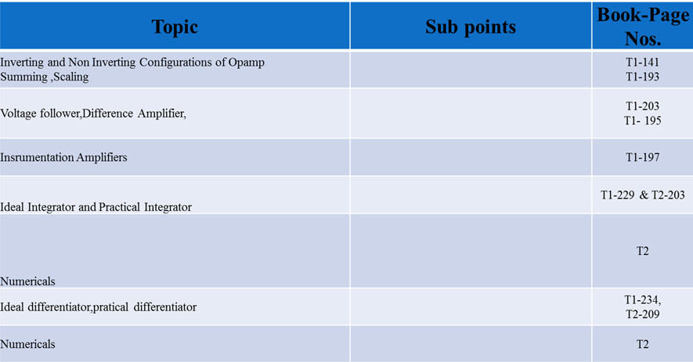
Lesson Plan
Notes:
T1: Ramakant A. Gayakwad, Op-Amps and Linear Integrated Circuits. New Delhi: PHI, 4th Edition, 2015
T2: Salivahanan and V. S. Kanchana Bhaaskaran, Linear Integrated Circuits. New Delhi: McGraw Hill Education Pvt. Ltd, 2nd Edition, 2014

Slide 3
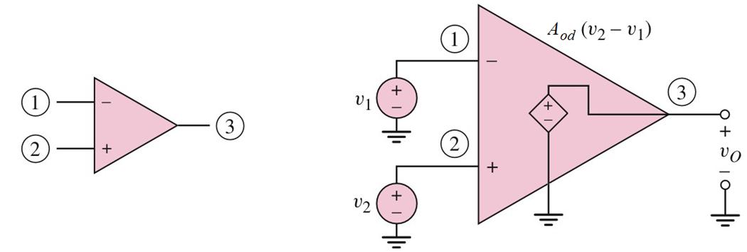
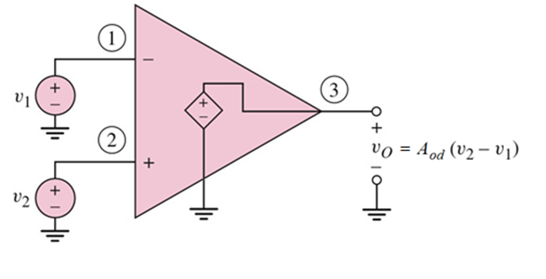
inverting
output
non-inverting
Op-amp circuit symbol
Open loop mode
V_{o} = A_{od} ( v₂ – v₁)
A_{od} is referred to as the open loop gain.
Notice that is v₂ = v₁, the open loop gain equals to ∞

Slide 4
Op amp can be configured to be used for different type of circuit applications:
Inverting Amplifier
Non – inverting Amplifier
Summing Amplifier
Difference
Integrator
Differentiator

Slide 5
Two main characteristics:
We want the open loop gain to be equal to ∞ which means that v₂ = v₁
We also want the input resistance to be equal to ∞ , hence there is no current going into the op-amp
0
0

Slide 6
Virtual short and Virtual ground
Voltage between inverting and non-inverting terminals of OPAMP is output voltage divided by open loop gain of OPAMP. Open loop gain being very large, this voltage is very small. Practically zero. This is virtual short.
Virtual ground concept is NOT valid for positive feedback or open loop operation of OPAMP.
Unlike actual short, there is no current through this short. Hence the term VIRTUAL.

Slide 7
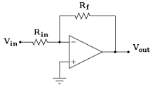
Virtual Ground
If the non-inverting (+) terminal of OP-AMP is connected to ground, then due to the "virtual short" existing between the two input terminals, the inverting (-) terminal also be at ground potential. hence it is said to be as "virtual ground".
Vo = (V1 – V2)
Av

Slide 8
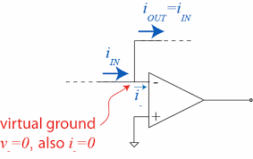
Virtual Short
The input impedance (Ri) of an OP-AMP is ideally infinite. Hence current "I" flowing from one input terminal to the other will be zero.
Thus the voltage drop across Ri will be zero and both input terminals will be at the same potential. In other words they are virtually shorted to each other.

Slide 9
Why the applications are called as Linear Applications?

Slide 10
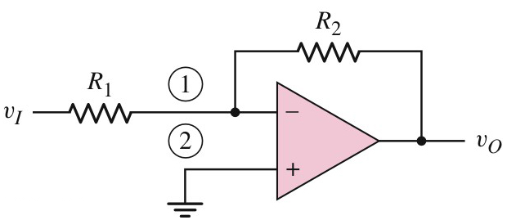
Inverting Amplifier
Op-amp as an inverting amplifier
Voltage at node 1 (inverting) = voltage at node 2 (non-inverting ) KCL at node 1:
(V_{i} – 0) / R₁ = (0 – V_{o}) / R₂
V_{i} / R₁ = - V_{o} / R₂
V_{o} = - R₂
V_{i} R₁

Slide 11
Exercise
Gain = - (R₂ / R₁) = -(150/12) = -12.5

Slide 12
Can the voltage gain be calculated using the same formula?
Try and use the same method in deriving V_{o}/V_{i}

Slide 13
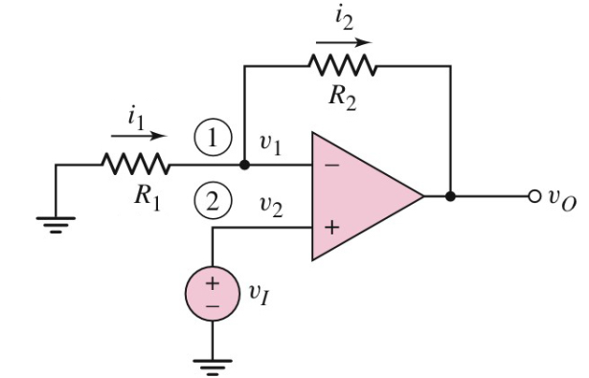
Non - Inverting Amplifier
Voltage at node 1 (inverting) = voltage at node 2 (non-inverting ) KCL at node 1:
(0– V_{i}) / R₁ = (V_{i} – V_{o}) / R₂
-(V_{i} / R₁) = (V_{i} / R₂) – (V_{o} / R₂)
V_{o} / R₂ = (V_{i} / R₂) + (V_{i} / R₁) = V_{i} 1 + 1
V_{o} / V_{i} = R₂ 1 + 1
R₂
R₁
Noninverting amplifier
R₂
R₁

Slide 14
Comparison of Inverting and Non Inverting Amplifier
Sr. No. | Parameter | Inverting Amplifier | Non Inverting Amplifier
1 | Voltage Gain
2 | Phase shift between input and output
3 | Input resistance | Equal to R1 | Very large

Slide 15
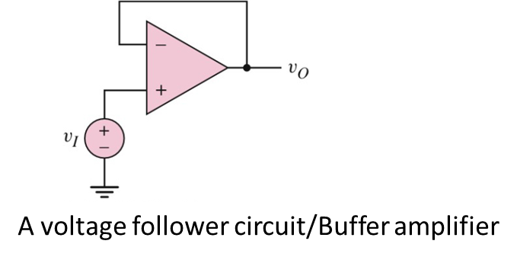
Voltage Follower / Buffer Amplifier
V_{o} = V_{i}
Hence, gain = 1

Slide 16
Summing Amplifier
i₁ + i₂ + i₃ – i₄ – 0 = 0
Example
Design a summing amplifier as shown in figure to produce a specific output signal, such that v_{o} = 1.25 – 2.5 cos ωt volt. Assume the input signals are v_{I1} = -1.0 V, v_{I2} = 0.5 cos ωt volt. Assume the feedback resistance R_{F} = 10 kΩ

Slide 18
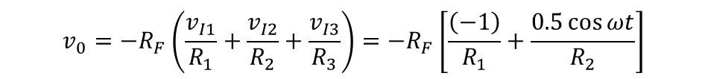
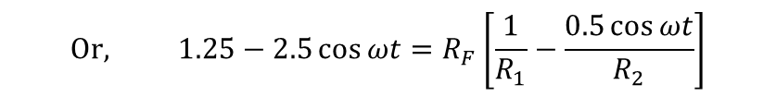
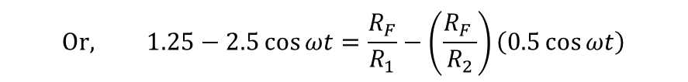


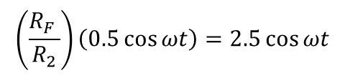

Solution: output voltage

Slide 19
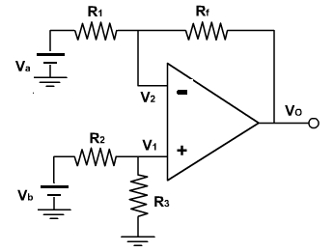
Difference Amplifier
https://nptel.ac.in/courses/117107094/12

Slide 20
Since there are two inputs superposition theorem can be used to find the output voltage. When V_{b}= 0, then the circuit becomes inverting amplifier, hence the output due to V_{a} only is
V_{o(a)} = -(R_{f} / R₁) V_{a}
Similarly when, V_{a} = 0, the configuration is a non-inverting amplifier having a voltage divided network at the non-inverting input

Slide 21
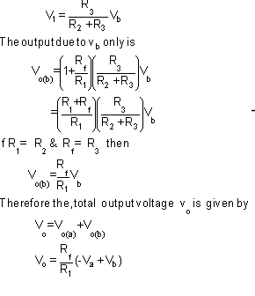
Exaples: https://nptel.ac.in/courses/117107094/12

Slide 22
Instrumentation Amplifier
Why IA?
-An instrumentation amplifier is a differential amplifier optimized for high input impedance and high CMRR. An instrumentation amplifier is typically used in applications in which a small differential voltage and a large common mode voltage are the inputs.
-An instrumentation amplifier is a type of differential amplifier that has been outfitted with input buffer amplifiers, which eliminate the need for input impedance matching and thus make the amplifier particularly suitable for use in measurement and test equipment.

Slide 23
There are many commercially available single chip instrumentation amplifiers in the market like AD 620. Several issues have to be taken into consideration for the design of a signal conditioning circuit. Linearity, sensitivity, loading effect, bandwidth, common mode rejection are the important issues that affect the performance of the signal conditioning circuits.

Slide 25
It is basically a difference amplifier
In many industrial and consumer applications – Temperature , Pressure, flow etc.
It is used to amplify low level output signal of transducer
Requirement of IA:
Precise low level signal amplification
Low noise
Low thermal drift
High input impedance
Accurate closed loop gain
Low power dissipation
High CMRR
High Slew rate
Monolithic IA are AD521/524/624/625/620 – AMP - 01

Slide 26
Specifications
CMRR is a very important parameter for instrumentation circuit applications and it is desirable to use amplifiers of high CMRR when connected to instrumentation circuits.
High Ri
Low Ro
Low offsets
High gain

Slide 27
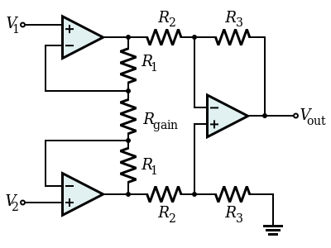

3 Op Amp based diagram
The gain of the circuit is

Slide 28
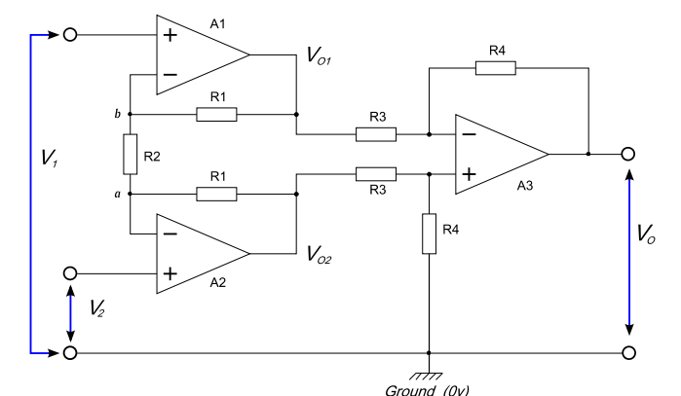

Slide 29


The first stage is a balanced input, balanced output amplifier formed by A1 and A2 which amplifies the differential signal but passes the common mode signal without amplification. The
second stage formed by A3 is a differential amplifier which largely removes the common mode signal.
The voltage VO1 consists of two components, the voltage due to V1 and the voltage due to V2.
If V2 = 0 then point a will be a virtual earth and amplifier A1 will act as a non inverting amplifier with a gain of
If V1 = 0 then point b will be a virtual earth and amplifier A1 will act as an inverting amplifier with a gain of

Slide 30
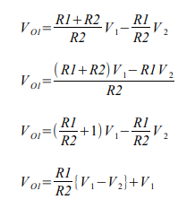


the output from amplifier A1 with respect to ground (0v) will be
Similarly the output from amplifier A2 with respect to ground will be
These two voltages are fed into a differential amplifier A3, the gain of this amplifier is given by

Slide 31



If we substitute the equations for VO2 and VO1 we get
After simplification

Slide 32
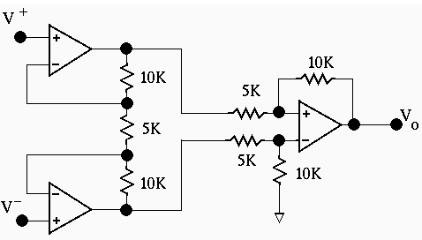
Numericals on IA
What is the gain of the instrumentation amplifier shown in Figure 2?
Ra = 10K
Rb = 5k
R1 = 5K
B2 = 10K
Av = (1 + 2Ra/Rb)(R2/R1) = (1 + 4)2 = 10

Slide 33
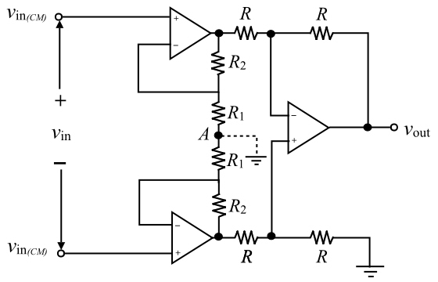

Slide 34
Applications of IA
Strain gauge bridge interface for pressure and temperature sensing.
A variety of low side and high side current sensing application
Medical instrumentation, used in ECG connection
Current/voltage monitoring
Audio application involving weak audio signal
High speed signal conditioning

Slide 35
Applications of IA…
In Data acquisition from low output transducers such as strain gauges, Thermocouples, Wheatstone bridge measurements e.t.c
In Medical instrumentation, Navigation, Radar instrumentation e.t.c
In Audio applications involving low amplitude audio signals in noisy environments to improve the signal to noise ratio;
High-speed signal conditioning for video data acquisition and imaging
High frequency signal amplification in cable RF systems.

Slide 36
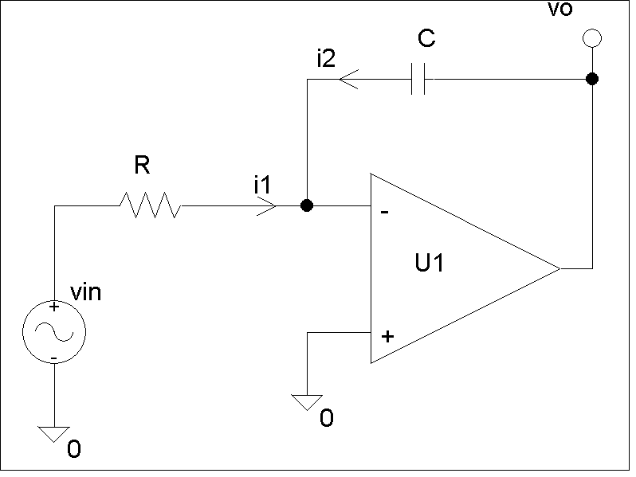
Integrator
The inverting input is at virtual ground. Hence,
Applying KCL at the inverting input
i₁+i₂ = 0

Slide 37
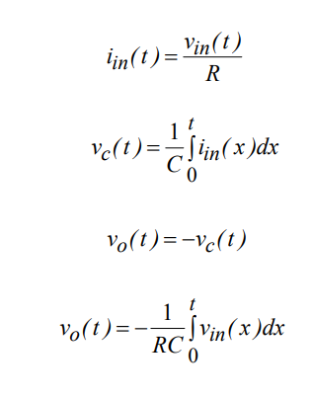
Ideal Integrator

Slide 38
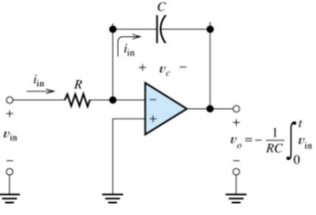

Slide 39
As the feedback capacitor, C begins to charge up due to the influence of the input voltage, its impedance Xc slowly increase in proportion to its rate of charge. The capacitor charges up at a rate determined by the RC time constant, ( τ ) of the series RC network. Negative feedback forces the op-amp to produce an output voltage that maintains a virtual earth at the op-amp’s inverting input.
Since the capacitor is connected between the op-amp’s inverting input (which is at earth potential) and the op-amp’s output (which is negative), the potential voltage, Vc developed across the capacitor slowly increases causing the charging current to decrease as the impedance of the capacitor increases. This results in the ratio of Xc/Rin increasing producing a linearly increasing ramp output voltage that continues to increase until the capacitor is fully charged.

Slide 40
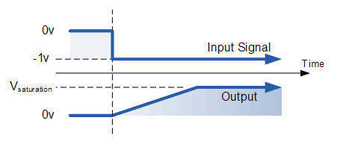
At this point the capacitor acts as an open circuit, blocking any more flow of DC current. The ratio of feedback capacitor to input resistor ( XC/RIN ) is now infinite resulting in infinite gain. The result of this high gain (similar to the op-amps open-loop gain), is that the output of the amplifier goes into saturation as shown below. (Saturation occurs when the output voltage of the amplifier swings heavily to one voltage supply rail or the other with little or no control in between).

Slide 41
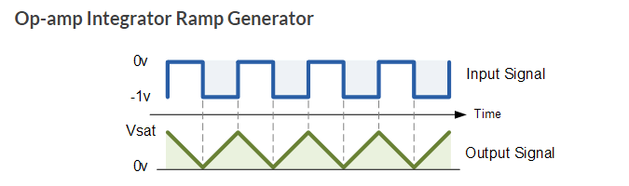
If we apply a constantly changing input signal such as a square wave to the input of an Integrator Amplifier then the capacitor will charge and discharge in response to changes in the input signal. This results in the output signal being that of a sawtooth waveform whose output is affected by the RC time constant of the resistor/capacitor combination because at higher frequencies, the capacitor has less time to fully charge. This type of circuit is also known as a Ramp Generator and the transfer function is given below.

Slide 42
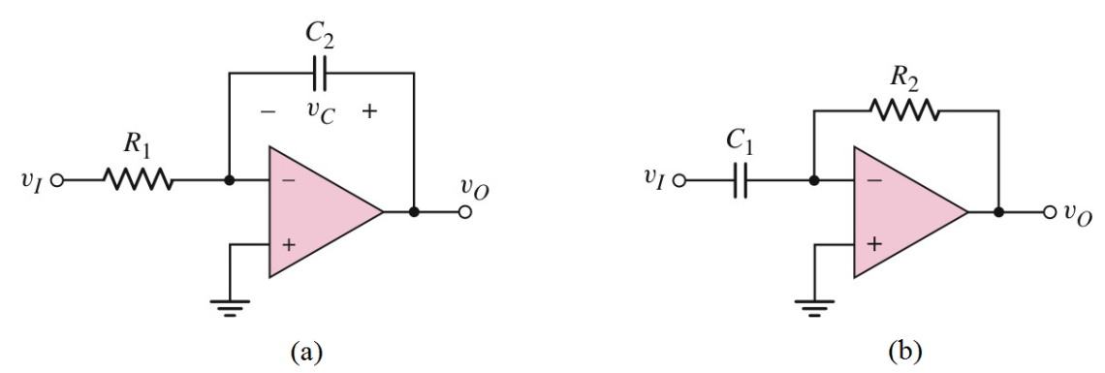
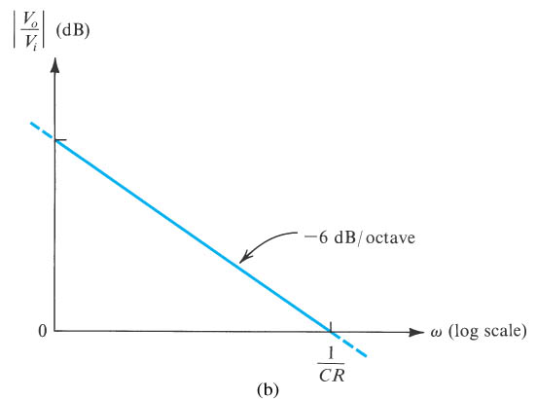
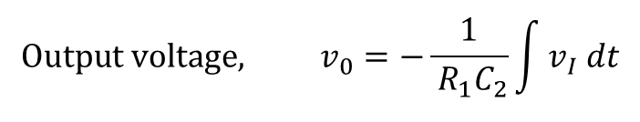

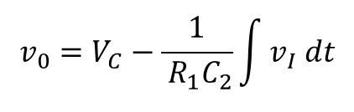
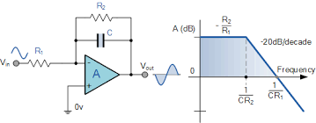
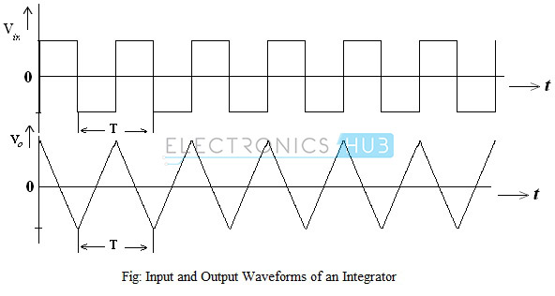
Integrator
Integrator circuit
The feedback resistor limits the low frequency gain and hence minimizes the variations in the output voltage

Slide 43
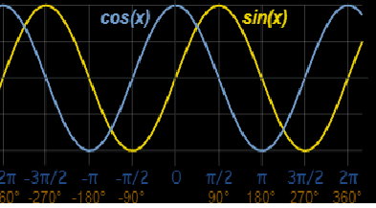

Slide 44
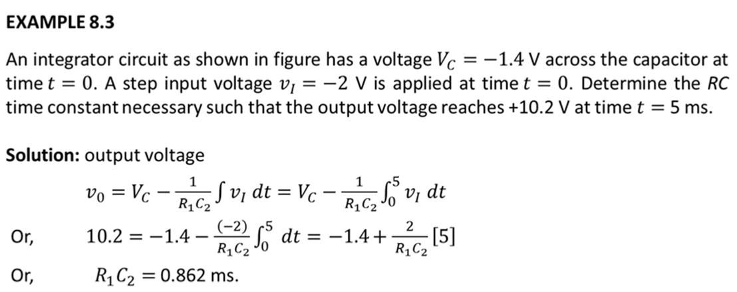
Ideal Integrator
Integrator circuit

Slide 45
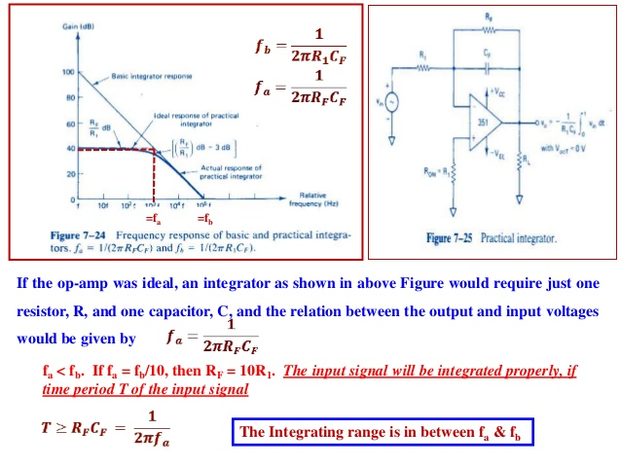
Practical Integrator
,the gain limiting frequency

Slide 46
The AC or Continuous Op-amp Integrator
If we changed the above square wave input signal to that of a sine wave of varying frequency the Op-amp Integrator performs less like an integrator and begins to behave more like an active “Low Pass Filter”, passing low frequency signals while attenuating the high frequencies.
At 0Hz or DC, the capacitor acts like an open circuit blocking any feedback voltage resulting in very little negative feedback from the output back to the input of the amplifier. Then with just the feedback capacitor, C, the amplifier effectively is connected as a normal open-loop amplifier which has very high open-loop gain resulting in the output voltage saturating.
This circuit connects a high value resistance in parallel with a continuously charging and discharging capacitor. The addition of this feedback resistor, R2 across the capacitor, C gives the circuit the characteristics of an inverting amplifier with finite closed-loop gain of R2/R1. The result is at very low frequencies the circuit acts as an standard integrator, while at higher frequencies the capacitor shorts out the feedback resistor, R2 due to the effects of capacitive reactance reducing the amplifiers gain.
Notes:
https://www.electronics-tutorials.ws/opamp/opamp_6.html

Slide 47
Applications of Integrator
In Analog Computers
Analog to Digital Converters
Signal Wave shaping circuits

Slide 48
Numericals on integrator

Slide 49
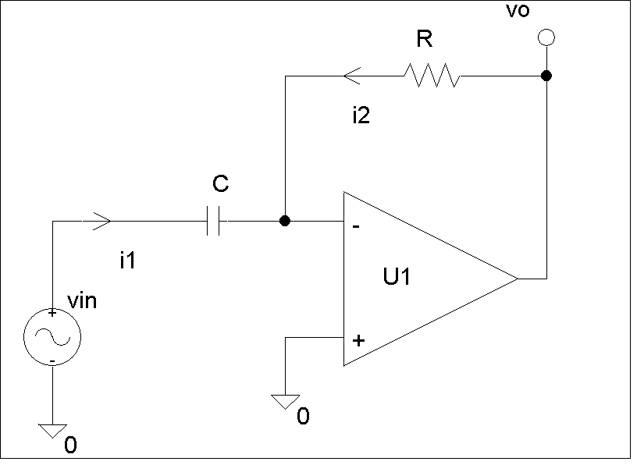
Differentiator
Since the inverting input is at virtual ground
Applying KCL at the inverting input
i₁+i₂ = 0
Differentiators are not preferred in practice as they amplify noise (high frequencies)

Slide 50
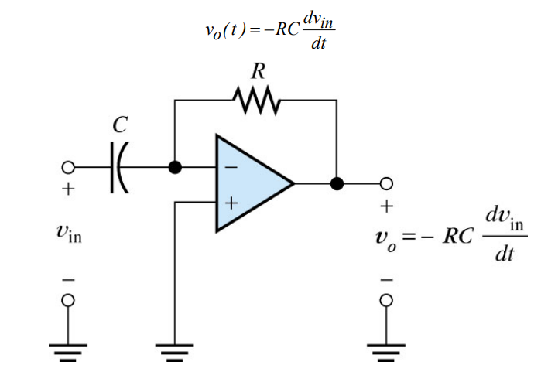
Rf/Xc- unstable
High freq noise susceptible

Slide 51
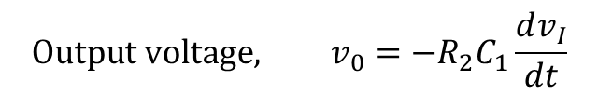
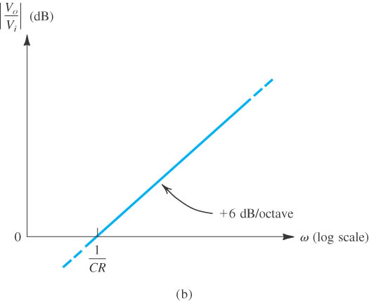
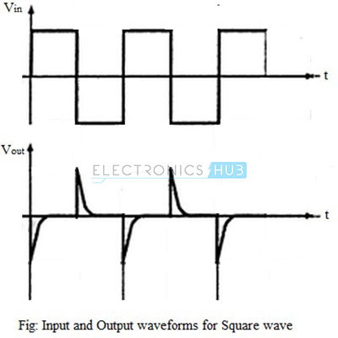
Differentiator
Differentiator circuit

Slide 52
For an ideal differentiator, the gain increases as frequency increases. Thus, at some higher frequencies, the differentiator may become unstable and cause oscillations which results in noise.

Slide 53
Frequency Response of Practical Differentiator
The gain of the practical differentiator increases with increasing frequency and at a particular frequency, f₁, the gain becomes the unity (0 dB). The gain continues to increase at a rate of 20dB per decade till the input frequency reaches a frequency, f₂.
Beyond this frequency of the input signal, the gain of the differentiator starts to decrease at a rate of 20dB per decade. This effect is due to the addition of the resistor R₁ and capacitor C_{f}. The frequency response curve of a practical differentiator is as shown in the figure below.
in order to reduce the overall closed-loop gain of the circuit at high frequencies, an extra resistor, Rin is added to the input

Slide 54
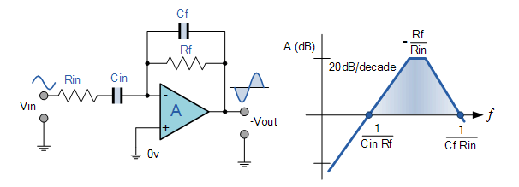
Adding the input resistor R_{IN} limits the differentiators increase in gain at a ratio of Rƒ/R_{IN} The circuit now acts like a differentiator amplifier at low frequencies and an amplifier with resistive feedback at high frequencies giving much better noise rejection.
Additional attenuation of higher frequencies is accomplished by connecting a capacitor Cƒ in parallel with the differentiator feedback resistor, Rƒ. This then forms the basis of a Active High Pass Filter

Slide 55
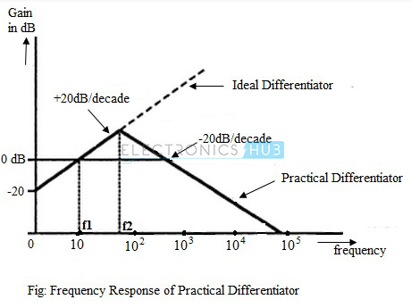

Slide 56
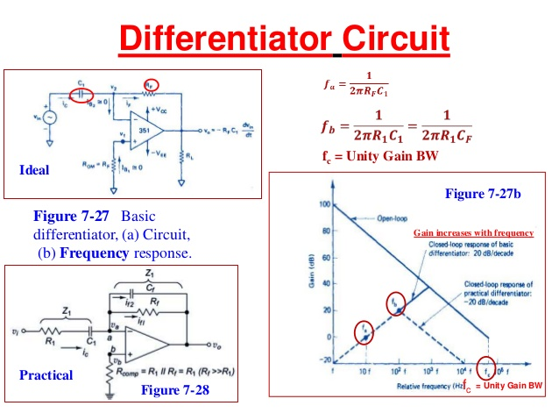
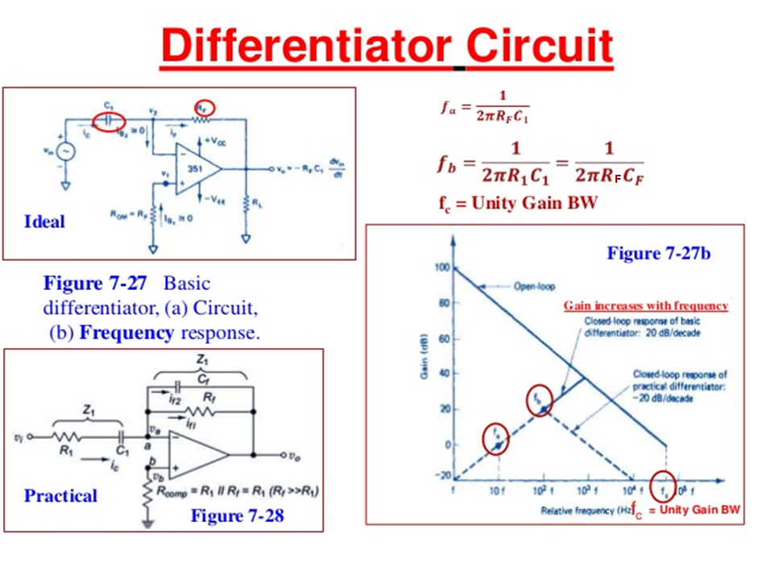

Slide 57
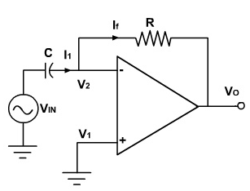
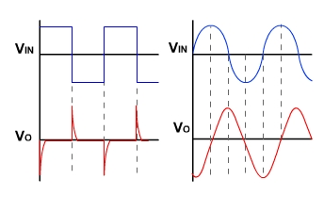
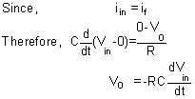
Ideal Differentiator
The expression for the output voltage can be obtained from the Kirchoff's current equation written at node v₂.

Slide 58
The input signal will be differentiated properly if the time period T of the input signal is larger than or equal to Rf C.
T ≥Rf C1
As the frequency changes, the gain changes. Also at higher frequen­cies the circuit is highly susceptible at high frequency noise and noise gets amplified. Both the high frequency noise and stability problem can be corrected by additing, few components.

Slide 59
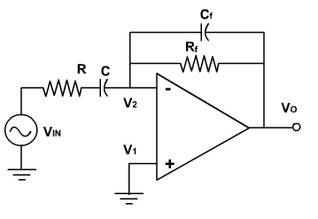
Practical Differentiator

Slide 60
Limitations of Differentiator
Limitations are due to noise, stability and input impedance.
In order to minimize noise and aid in stability, a small capacitor is placed in parallel with feedback resistor which will reduce high frequency gain.
In order to place lower limit on the input impedance, a resistor may be connected in series with a differentiating capacitor
The gain of practical differentiator circuit is reduced significantly and this avoids the high frequency noise and results in better stability.

Slide 61
Applications of Differentiators
In wave shaping circuits to detect high frequency components in an input signal
As a rate of change detector in FM modulators.

Slide 62
Design Steps of differenciators
Select Fa = highest freq of the input signal to be differentiated, choose C1<1microfarad, calculate RF
Choose fb = 20fa, calculate R1 and CF so that R1C1 = RFCF

Slide 63


Design a differentiator to differentiate an input signal that varies in the frequency from 10Hz to about 1 KHz
Sol:
1.Fa = 1KHZ
Let C1 = 0.1microF, RF = 1.59Kohm= 1.5kohm
2. Fb = 20kHz
R1 = 79.5ohm =82 ohm. R1C1 = RfCf
Cf = 0.0055microfarad
Rom = RF = 1.5kohm

Slide 64
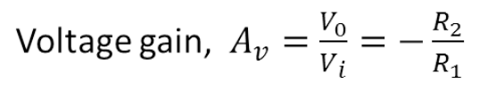
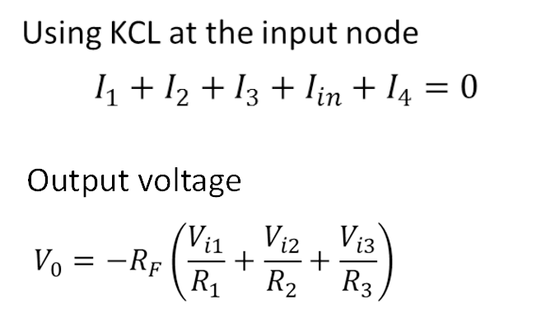
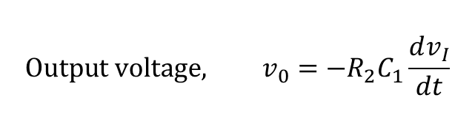
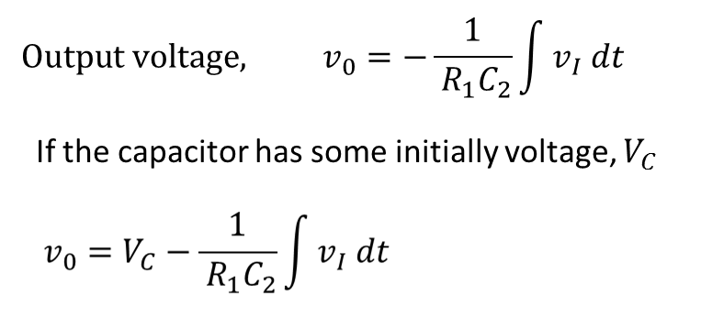
Calculating Gain and Design Questions
INVERTING
NON - INVERTING
Calculating Output and Design Questions
SUMMING AMPLIFIER
INTEGRATOR AMPLIFIER
DIFFERENTIATOR AMPLIFIER

Slide 65

Va
Vb
NON - INVERTING
INVERTING
INVERTING
Calculate the input voltage if the final output, V_{O} is 10.08 V.
Finally:
Va = (1 + 10/5) V₁
0.504 = 3V₁
V₁ = 0.168 V
Then:
Vb = -(5/5) Va
-0.504 = - Va
Va = 0.504 V
Have to work backwards:
Vo = -(100/5) Vb
10.08 = -20 Vb
Vb = -0.504 V

Slide 66

What is the value of V_{in1} from the figure above?
12 = - 24 [ V_{in1} / 24 + (-2) / 24 + (-6) / 24 ]
12 = - [ V_{in1} – 2 – 6 ]
12 = - V_{in1} + 2 + 6
V_{in1} = - 4 V

Slide 67

Va
INVERTING
SUMMING
Calculate the output voltage, V_{O} if V₁ = V₂ = 700 mV
Va = -(500/250) 0.7
Va = -1.4 V
Then:
Vo = - 500 [ V_{a} / 100 + V₂ / 50 ]
Vo = - 500 [ -1.4 / 100 + 0.7 / 50 ]
Vo = 0 V

Slide 68

Calculate the output voltage V_{O} of the operational amplifier circuit as shown in the figure.

Slide 69
week 10 assignment https://nptel.ac.in/courses/108108111/W10A1.pdf

Slide 70

Sketch the output voltage waveform vo (t) for the circuit shown, given the input voltage waveform below

Slide 71


Slide 72

If v1 (t) = 10cos(2t) mV and v2 (t) = 0.5t mV below, find vo (t) for t > 0. Assume that the voltage across the capacitor is zero at t = 0.

Slide 73



the output voltage is

